Slide 1

LINEAR CONTROL
SYSTEMS
Ali Karimpour
Assistant Professor
Ferdowsi University of Mashhad
Notes:
<<<1.1>>>
###Control System Design###
{{{Control, Design}}}

Slide 2
Lecture 19
Time domain design of control systems
Topics to be covered include:
Time domain design of the PID controllers.
  Design of PID controllers.
  Design of PD controllers.
  Design of PI controllers.

Slide 3
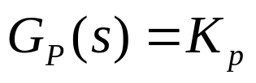
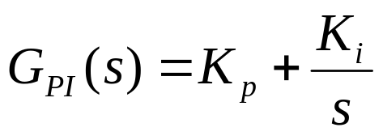
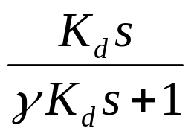
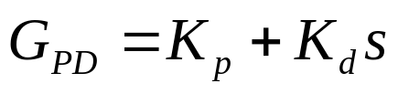
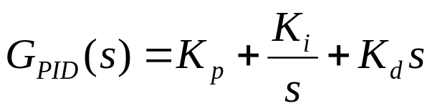
PID Controllers
کنترلر PID
The standard form PID are:
Proportional only:
Proportional plus Integral:
Proportional plus derivative:
Proportional, integral and
derivative:

Slide 4
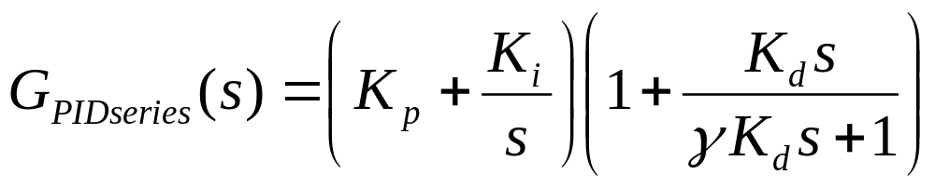
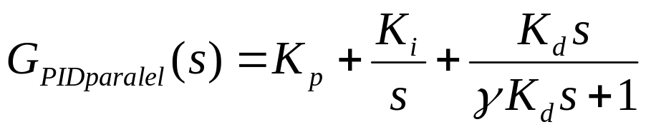
PID Controllers
کنترلر PID
An alternative series form is:
Yet another alternative form is the, so called, parallel form:

Slide 5
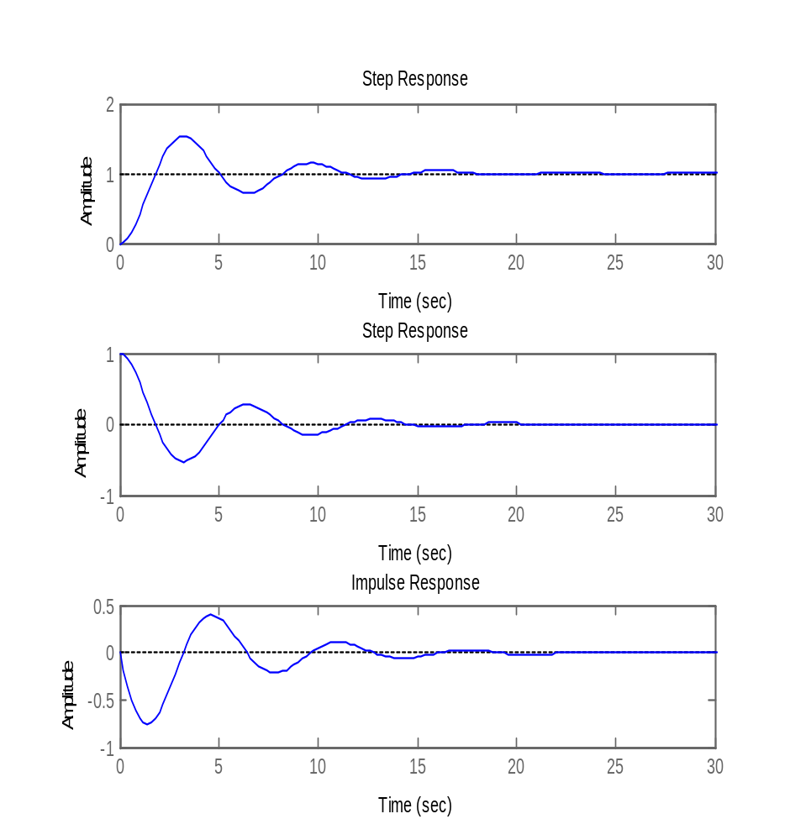



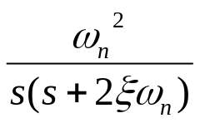





Effects of the PD control on the time response.
تاثیر کنترلر PD بر پاسخ زمانی
+
+
-
+
PD controller
Derivative part can improve
the oscillation.
جمله مشتق می تواند رفتار گذرا را بهبود بخشد.

Slide 6

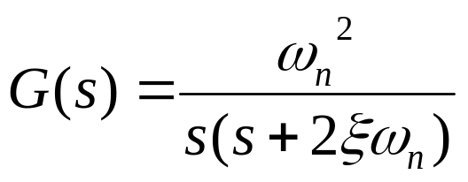
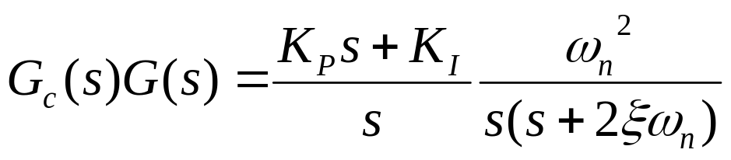
Effects of the PI control on the time response.
تاثیر کنترلر PI بر پاسخ زمانی
+
+
-
+
PI controller
Loop transfer function without controller
Loop transfer function with controller
PI controller can improve error by increases the type of system by one

Slide 7
Tuning of PID Controllers
تنظیم کنترلرهای PID
Because of their widespread use in practice, we present below several methods for tuning PID controllers. Actually these methods are quite old and date back to the 1950’s. Nonetheless, they remain in widespread use today.
In particular, we will study.
  Ziegler-Nichols Oscillation Method
  Ziegler-Nichols Reaction Curve Method
  Cohen-Coon Reaction Curve Method
  Time domain design
  Frequency domain design
Notes:
<<<6.3>>>
###PID Tuning###

Slide 8
Ziegler-Nichols Oscillation Method
طراحی زیگلر نیکولز بروش نوسانی
This procedure is only valid for open loop stable plants and it is carried out through the following steps
  Set the true plant under proportional control, with a very small gain.
  Increase the gain until the loop starts oscillating. Note that linear oscillation is required and that it should be detected at the controller output.
  Record the controller critical gain K_{c} and the oscillation period of the controller output, T.
  Adjust the controller parameters according to Table
Notes:
<<<6.4>>>
###Ziegler-Nichols Oscillation Method###
{{{Ziegler-Nichols}}}

Slide 9


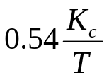

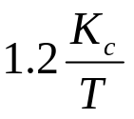

Ziegler-Nichols Oscillation Method
طراحی زیگلر نیکولز بروش نوسانی
K_{p}
K_{i}
K_{d}
P
PI
PID
Notes:
<<<6.4>>>
###Ziegler-Nichols Oscillation Method###
{{{Ziegler-Nichols}}}

Slide 10
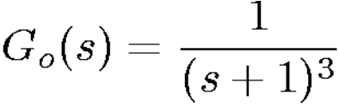
Numerical Example
مثال عددی
Consider a plant with a model given by
Find the parameters of a PID controller using the Z-N oscillation method. Obtain a graph of the response to a unit step input reference.

Slide 11
Solution
حل
Applying the procedure we find:
K_{c} = 8 and ω_{c} = √3. T=3.62
Hence, from Table, we have
The closed loop response to a unit step in the reference at t = 0 is shown in the next figure.

Slide 12
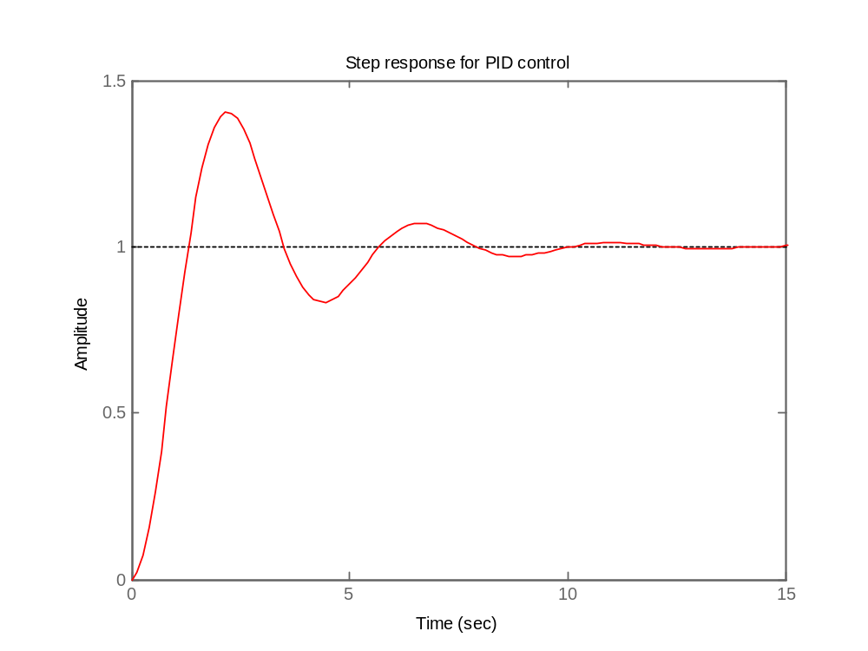
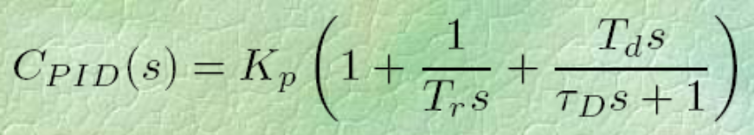
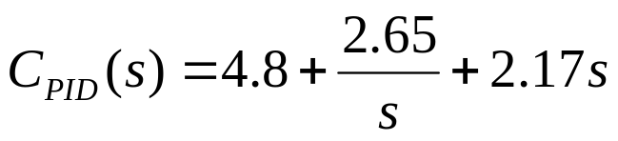
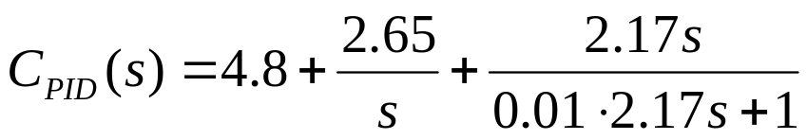
Response to step reference
پاسخ سیستم به پله

Slide 13
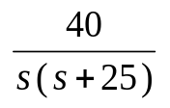






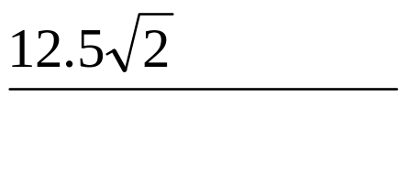




Time domain design
طراحی حوزه زمانی
Is it possible to set the value of k such that the damping ratio of complex poles be 0.707?
Yes
در سیستم زیر آیا می توان k را بگونه ای تنظیم کرد که نسبت میرائی قطبهای مختلط سیستم 0.707 گردد؟
بله
+
-
-25
0

Slide 14

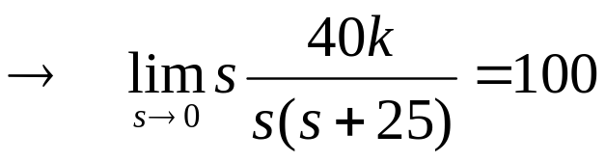


Time domain design
طراحی حوزه زمانی
Is it possible to set the value of k such that ramp error constant be 100?
Yes
در سیستم زیر آیا می توان k را بگونه ای تنظیم کرد که ثابت خطای شیب معادل 100 گردد؟
بله
+
-

Slide 15


Time domain design
طراحی حوزه زمانی
Is it possible to set the value of k such that the damping ratio of complex poles be 0.707 and ramp error constant be 100 ?
در سیستم زیر آیا می توان k را بگونه ای تنظیم کرد که نسبت میرائی قطبهای مختلط سیستم 0.707 و ثابت خطای شیب معادل 100 گردد ؟
+
-
Clearly the design is not possible
???!!!???
Other controllers

Slide 16
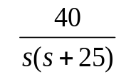



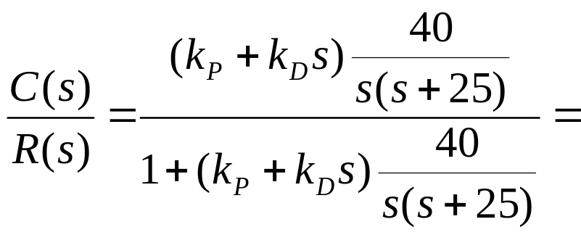
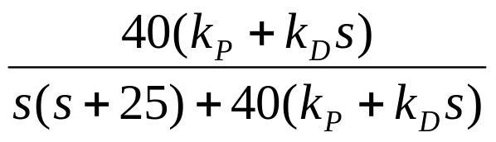
Tuning PD controller
طراحی کنترلر PD
Is it possible to set the value of k such that the damping ratio of complex poles be 0.707 and ramp error constant be 100 ?
در سیستم زیر آیا می توان k را بگونه ای تنظیم کرد که نسبت میرائی قطبهای مختلط سیستم 0.707 و ثابت خطای شیب معادل 100 گردد ؟
+
+
+
-
+
-

Slide 17

Tuning PD controller
طراحی کنترلر PD
Is it possible to set the value of k such that the damping ratio of complex poles be 0.707 and ramp error constant be 100 ?
در سیستم زیر آیا می توان k را بگونه ای تنظیم کرد که نسبت میرائی قطبهای مختلط سیستم 0.707 و ثابت خطای شیب معادل 100 گردد ؟
+
-
Root contour
Step 1: Let k_{D}=0 and find root loci for k_{P}
Step 2: Restor k_{D} and find root loci for k_{D}

Slide 18
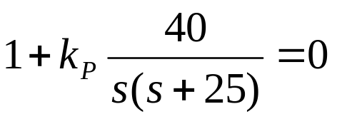
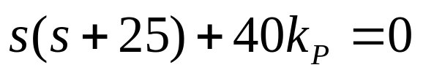
Tuning PD controller
طراحی کنترلر PD
Step 1: Let k_{D}=0 and find root loci for k_{P}
-25
0

Slide 19
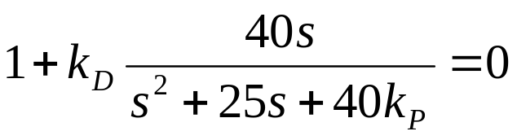


Tuning PD controller
طراحی کنترلر PD
Step 2: Restor k_{D} and find root loci for k_{D}
k_{P}=0
k_{P}=30
-25
0

Slide 20
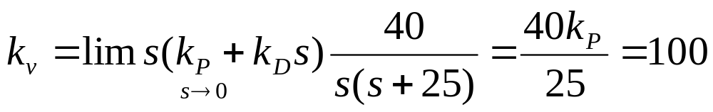

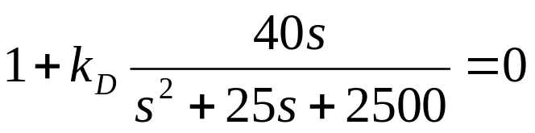
Tuning PD controller
طراحی کنترلر PD
Is it possible to set the value of k such that the damping ratio of complex poles be 0.707 and ramp error constant be 100 ?
در سیستم زیر آیا می توان k را بگونه ای تنظیم کرد که نسبت میرائی قطبهای مختلط سیستم 0.707 و ثابت خطای شیب معادل 100 گردد ؟
+
-

Slide 21


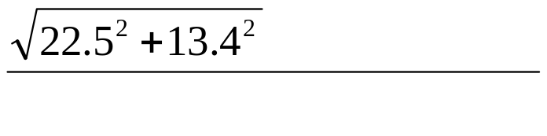





Tuning PD controller
طراحی کنترلر PD
+
-
Tuning k_{D} by graphical method.
48.4
-50
-35
-12.5

Slide 22

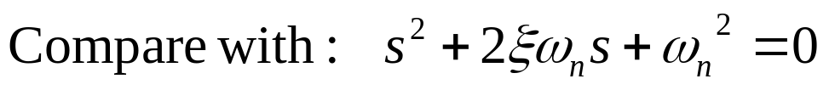
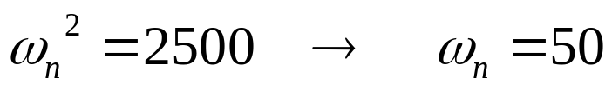
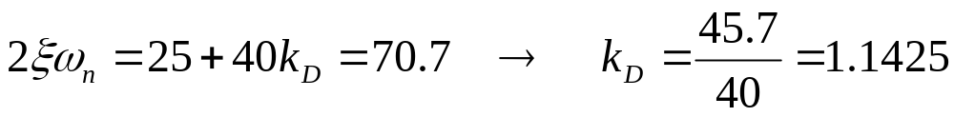
Tuning PD controller
طراحی کنترلر PD
+
-
Tuning k_{D} by mathematical method

Slide 23


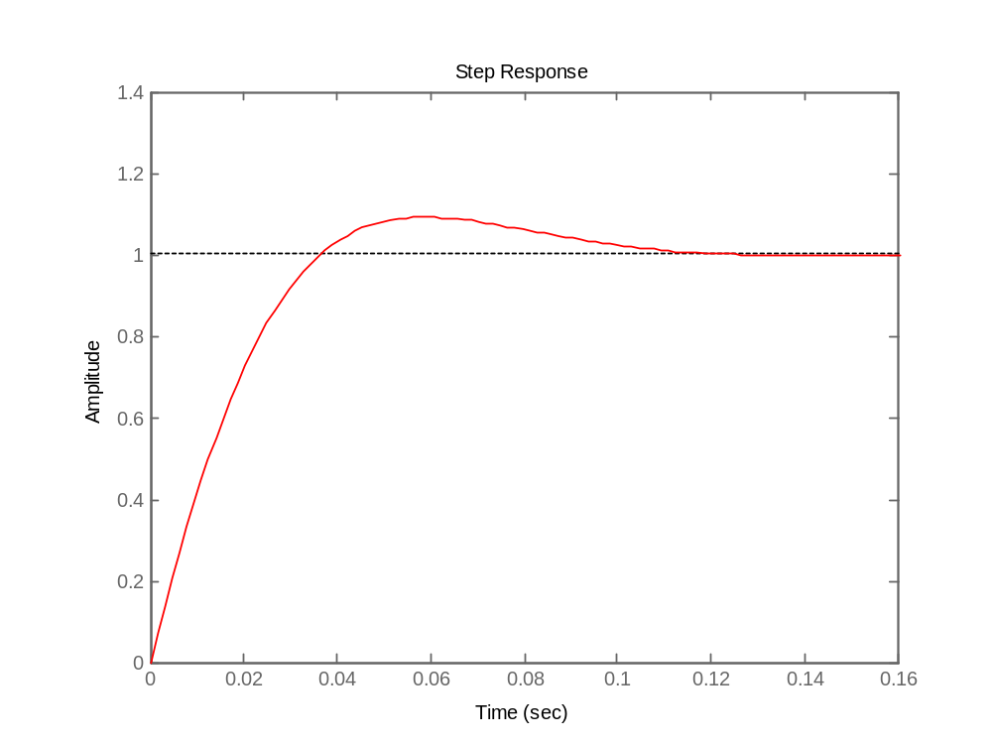
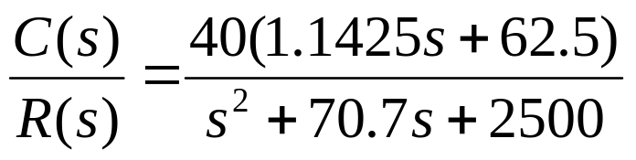
Tuning PD controller
طراحی کنترلر PD
+
-
Why P.O. > 4.3%

Slide 24
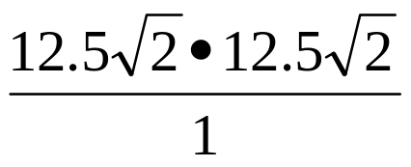
Time domain design
طراحی حوزه زمانی
Is it possible to set the value of k such that the damping ratio of complex poles be 0.707?
Yes
در سیستم زیر آیا می توان k را بگونه ای تنظیم کرد که نسبت میرائی قطبهای مختلط سیستم 0.707 گردد؟
بله
+
-
-25
0

Slide 25
Time domain design
طراحی حوزه زمانی
Is it possible to set the value of k such that ramp error constant be 100?
Yes
در سیستم زیر آیا می توان k را بگونه ای تنظیم کرد که ثابت خطای شیب معادل 100 گردد؟
بله
+
-

Slide 26
Time domain design
طراحی حوزه زمانی
Is it possible to set the value of k such that the damping ratio of complex poles be 0.707 and ramp error constant be 100 ?
در سیستم زیر آیا می توان k را بگونه ای تنظیم کرد که نسبت میرائی قطبهای مختلط سیستم 0.707 و ثابت خطای شیب معادل 100 گردد ؟
+
-
Clearly the design is not possible
???!!!???
Other controllers

Slide 27
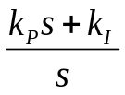

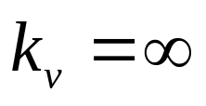
Tuning PI controller
طراحی کنترلر PI
Is it possible to set the value of k such that the damping ratio of complex poles be 0.707 and ramp error constant be 100 ?
در سیستم زیر آیا می توان k را بگونه ای تنظیم کرد که نسبت میرائی قطبهای مختلط سیستم 0.707 و ثابت خطای شیب معادل 100 گردد ؟
+
+
+
-
+
-
Clearly type of system is 2 so:

Slide 28
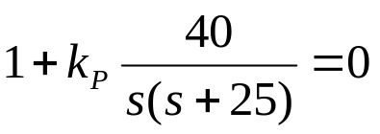
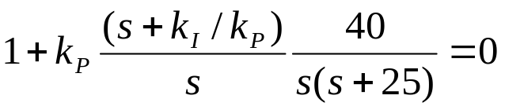


Tuning PI controller (Continue)
طراحی کنترلر PI (ادامه)
We now need damping ratio of complex poles be 0.707.
حال نیاز داریم که نسبت میرائی قطبهای مختلط سیستم 0.707 گردد.
+
Root loci with proportional controller
-
-25
0

Slide 29
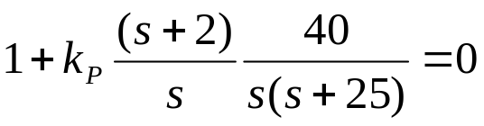




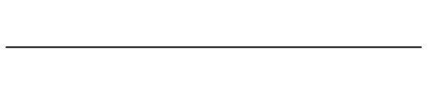


Tuning PI controller (Continue)
طراحی کنترلر PI (ادامه)
We now need to set k_{P}.
حال نیاز داریم که k_{P} را تعیین کنیم.
Root loci with PI controller
-25
-11.5
-10.9
-4.6
0

Slide 30
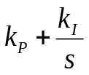


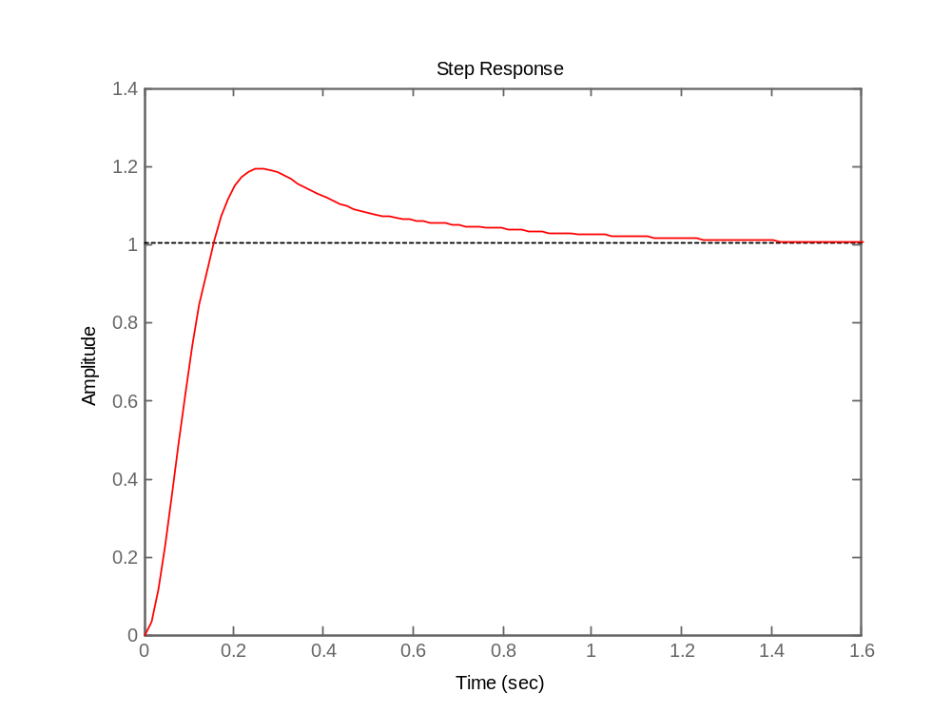
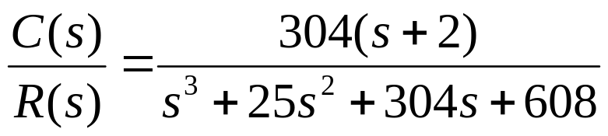

Tuning PI controller
طراحی کنترلر PI
+
-
Why P.O. > 4.3%

Slide 31


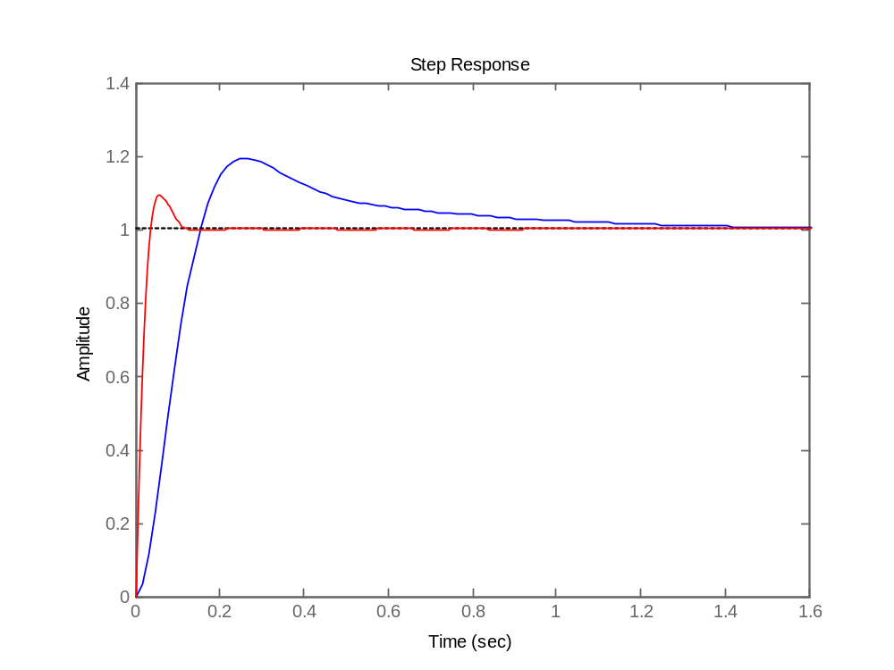
Compare PI and PD controllers
مقایسه کنترلرهای PI و PD
+
+
-
-
With PI controller
With PD controller

Slide 32
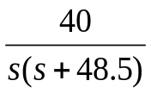

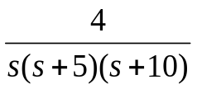
Exercises
تمرینها
1 In the following system design a PID controller with Ziegler-Nichols Oscillation Method
+
-
2 In the following system design a PID controller with Ziegler-Nichols Oscillation Method
+
-
Notes:
<<<3.6>>>
###State Space Models###

Slide 33
Exercises
تمرینها
3 In the following system design a PD controller such that that the damping ratio of complex poles be 0.6 and ramp error constant be 80.
+
-
4 In the following system design a PD controller such that that the damping ratio of complex poles be 0.6 and ramp error constant be 80.
+
-
Notes:
<<<3.6>>>
###State Space Models###

Slide 34
Exercises
تمرینها
5 In the following system design a PI controller such that that the damping ratio of complex poles be 0.6 and ramp error constant be 80.
+
-
6 In the following system design a PI controller such that that the damping ratio of complex poles be 0.6 and ramp error constant be 80.
+
-
Notes:
<<<3.6>>>
###State Space Models###

